Slide 1

Remember

Slide 2
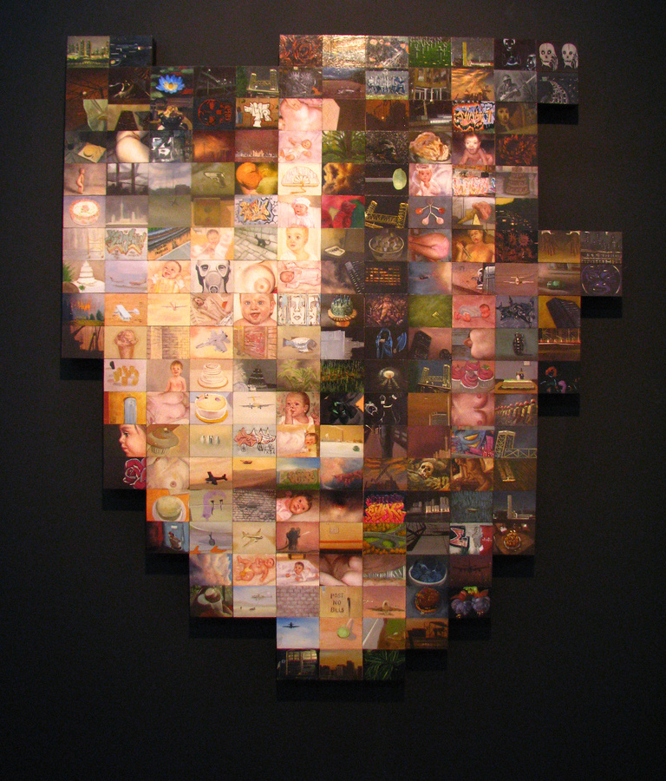
VISION
We are made of our memories
Photos, videos, etc
Give a meaning to photos holded by user

Slide 3
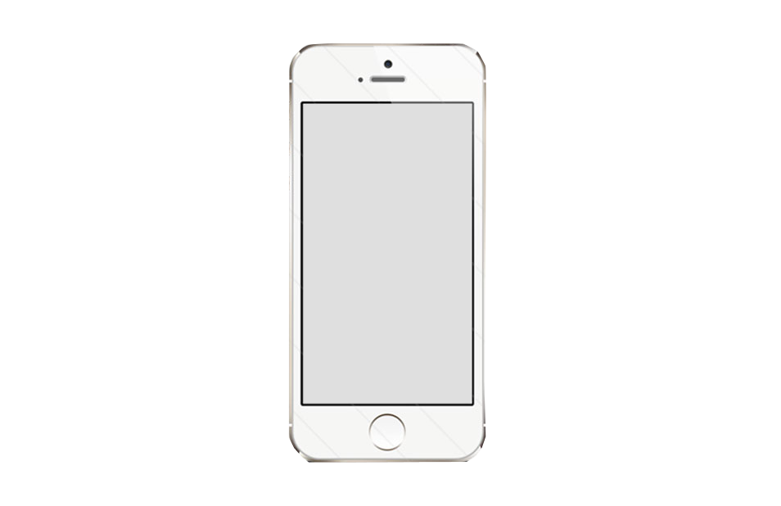
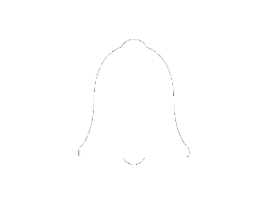
HOW IT WORKS
Look for
relevant photos around location
Remember Here!
Search for
tags
OR
Enjoy
your
Memory!
Open the app!

